Slide 1
Analysis & Prediction of Road Accident
By:-
Aniket Sahi, Abhishek Kumar, Shashank Chauhan, Ranjan Kumar

Slide 2
Overview
Road accidents are a serious problem that can cause injury, death, and economic damage.
According to the World Health Organization, around 1.3 million people die each year and approximately 3,700 deaths per day with road traffic crashes, with addition 20 to 50 million people suffering non-fatal injuries.
Why it's important to analyze and predict road accidents.
Identifing causes of an accident, patterns, and as well as to develop effective measures to prevent them.

Slide 3
Common Causes of Road Accidents
Distracted Driving- The number of accidents occurring due to distracted driving has increased in the past decades. Reading messages, replying to texts, taking calls, reading, grooming, etc. behind the wheel can be fatal.
Drunk Driving
Speeding/ Reckless Driving- Increase the speed when you are running late or are driving on an empty road and proved to be fatal most of the time. Reckless driving mostly leads to horrible accidents. Hence, it is advisable to drive within the legal limits even when you are running late.
Not Wearing Seat Belt- Reduces the chances of injuries during a head-to-head collision.
Bad Road Condition Seat Belt
Rain or Wet Roads
Breaking Traffic Rules- Few people tend to break them often and see no other vehicles coming, running a red light and breaking the law might cause a severe accident.

Slide 4
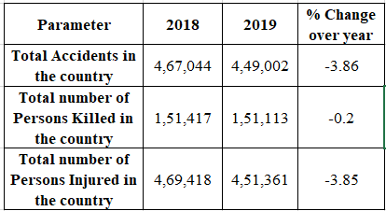
Analysis
The analysis and forecasting are done for top five metro states: Tamil Nadu, Maharashtra, West Bengal, Delhi, Gujarat.
We have taken data for modeling is from the year 2009 to 2019.
In state-wise comparison, top three states in road accidents in 2019 are Tamil Nadu, Madhya Pradesh, Uttar Pradesh. Tamil Nadu has 12.7% share in total no. of road accidents, while Madhya Pradesh has 11.3% and Karnataka has 9.5 % share

Slide 5
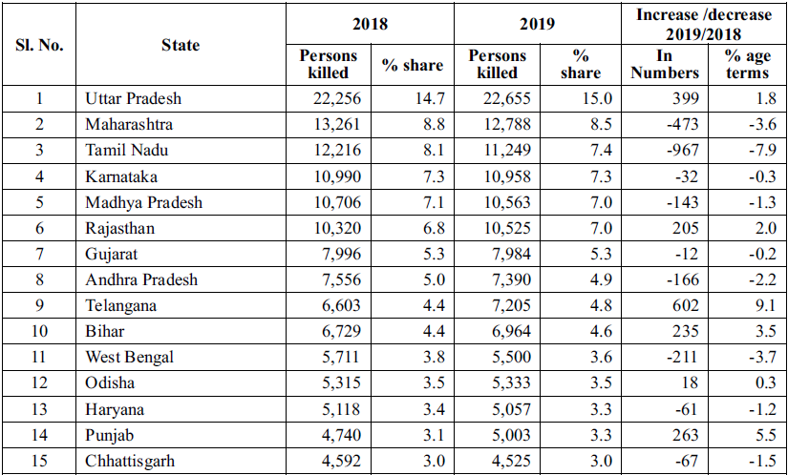
UP ranks 1st even in 2019 in terms of accident related deaths and has shown an increase of 1.8% over the previous year.
Top 15 states in term of accident related to death.

Slide 6
Methods
We have used linear regression mathematical models for the analysis and forecasting of road accident.
We have calculated moving average of data to generate trend line. After linear regression analysis and with help of trend equation we predict forecasting for next five years (till 2024)
We done each for top five metro states and four categories are listed below:
Total no. of road accidents
Total no. of people injured in road accidents
Total no. of people killed in road accidents
Total no. of people road accidents happened on National highways .

Slide 7
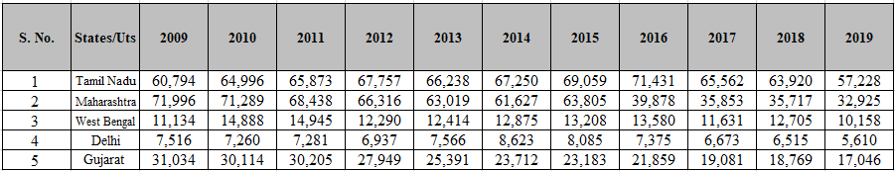
Analysis for total no. of road accidents:
The linear trend equation for the total number of accidents obtained using regression analysis is
Total no. of accident y = 42190 - 775.83x

Slide 8
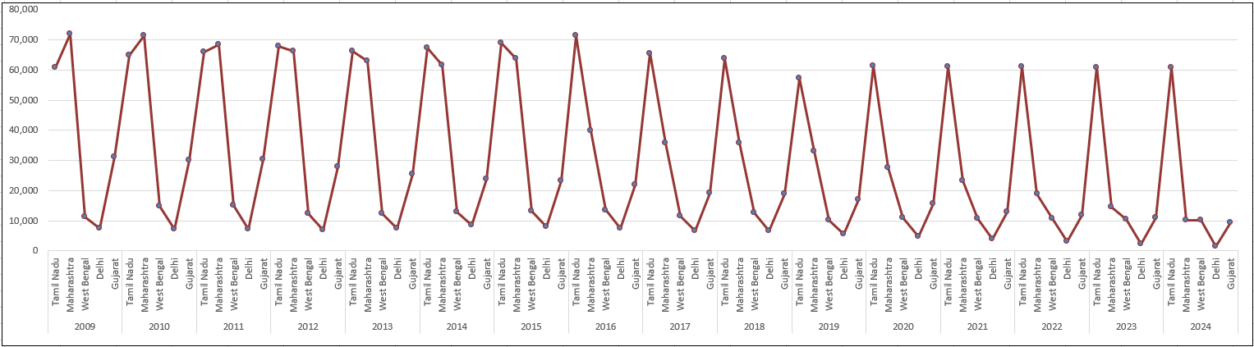
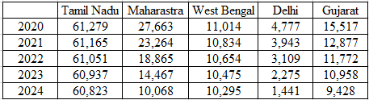
Forecasting for total no. of road accidents

Slide 9
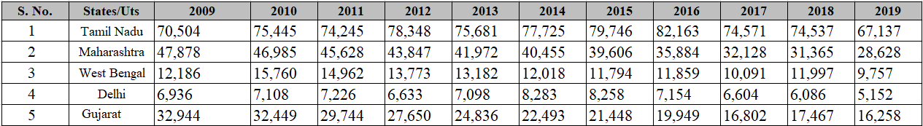
Analysis for total no. of people injured in road accidents:
The linear trend equation for the total number of injured people obtained using regression analysis is
Total no. of people injured y = 3966-650.73x

Slide 10
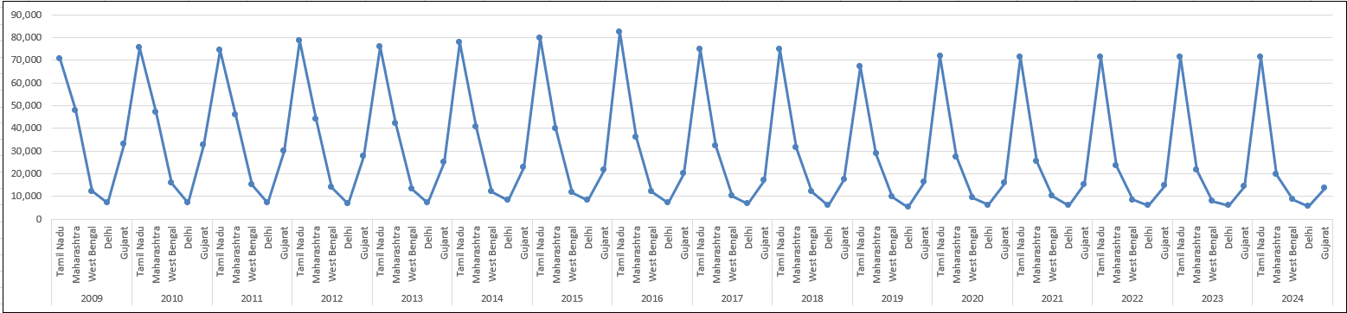
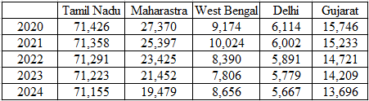
Forecasting for total no. of people injured in accidents

Slide 11
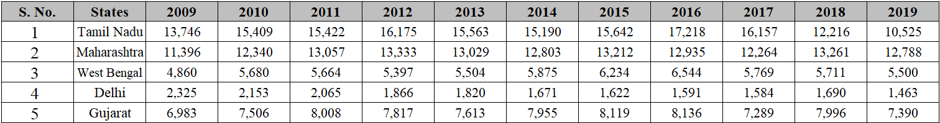
Analysis for total number of people killed in road accidents:
The linear trend equation for total no. of people killed in road accident obtained using regression analysis is
Total no. of people killed y = 10329 - 115.1x

Slide 12
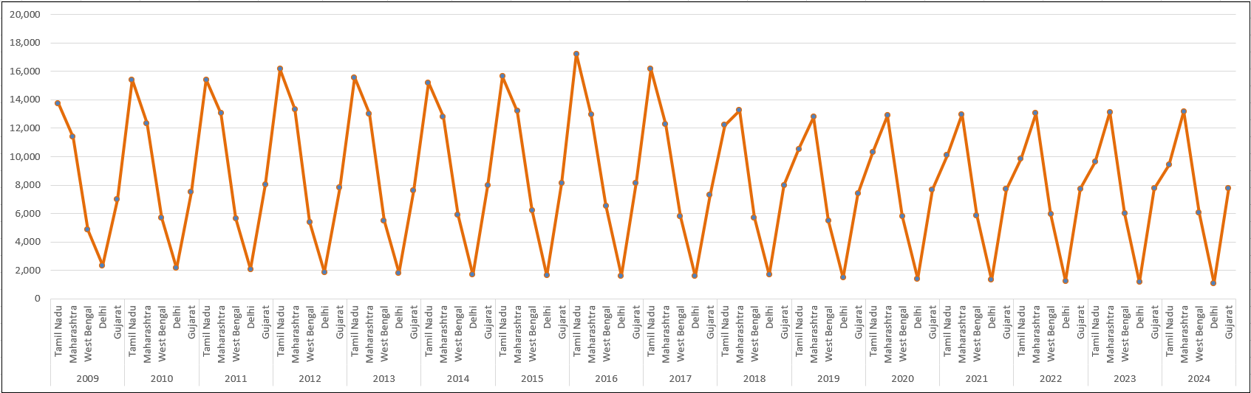
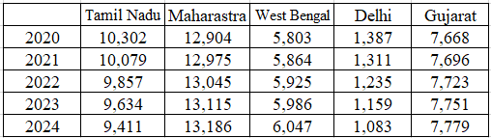
Forecasting for total no. of people killed in accidents:

Slide 13
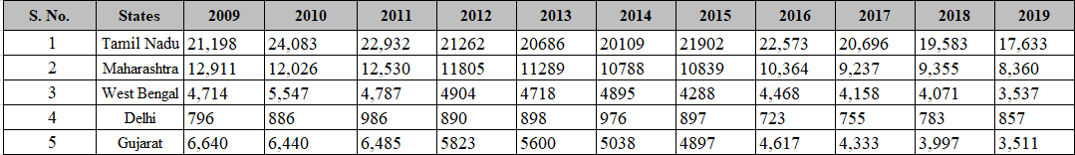
Analysis for total accidents on National highways:
The linear trend equation for road accident on National Highway to obtained using regression analysis is
Total no. of accident y = 10643 - 174.27x

Slide 14
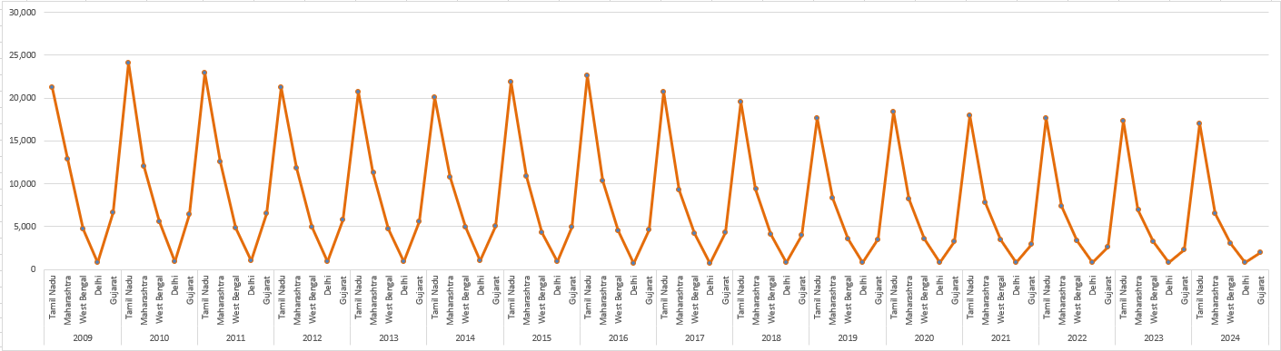
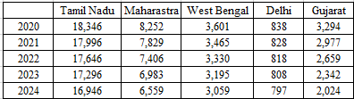
Forecasting for total accidents on National highways:

Slide 15
IMPORTANT WAYS TO AVOID ACCIDENTS
Drive in the prescribed speed limits on the various roads. Always remember that “Speed thrills but kills”.
Always put on helmets, seat belts and other safety equipments before driving a bicycle/ motor cycle/vehicle. Always remember that “Safety saves”.
Do not drink and drive. Always remember that “You cannot hold a pen properly after two pegs, what about the driving wheel?”
Never use mobile phones or ear phones while driving. Always remember “A mobile call on the road may be the last call of your life”.
Know the traffic signs, signals, lights and traffic safety rules before you hit the road. Always remember that “Road safety rules are best tools to avoid accidents”.
Do not drive for long hours in a stretch. Have a proper beaks after every 2 hours of continuous driving. Always remember that “Man is a man and not a machine”.

Slide 16
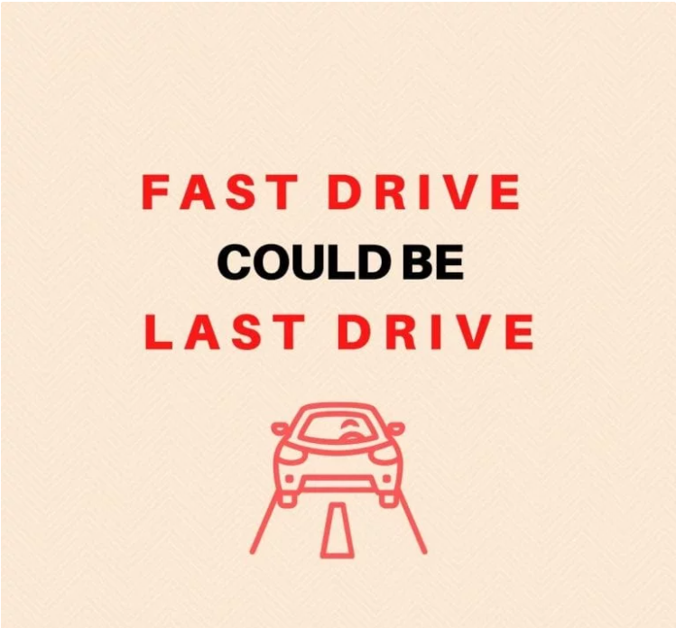

Slide 17
Thank you

